Slide 1
Impact Based Forecasting and Risk Based Warnings
Mark Bevan and Chris Tubbs
Session 1 - 01 November 2016

Slide 2
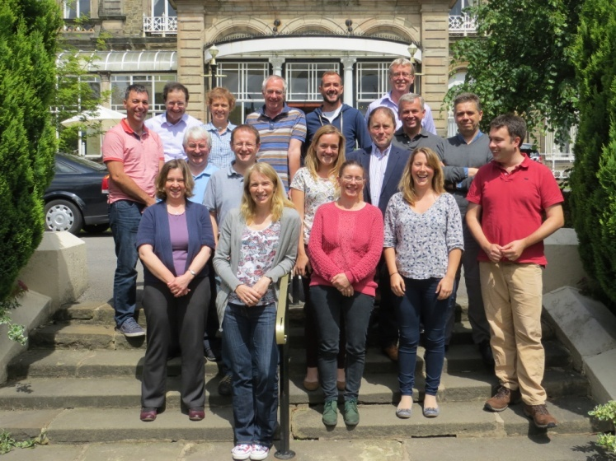
Mark Bevan Met Office Advisor (Civil Contingencies)
Background in Defence Forecasting (2003 to 2015)
Various Military locations across the UK.
Iraq, Afghanistan, Kenya and Bosnia (2¼ years overseas)
Forecaster at 2012 Olympic Games and 2014 Commonwealth Games
Now part of a team of 18 Civil Contingencies Advisors spread across the UK

Slide 3
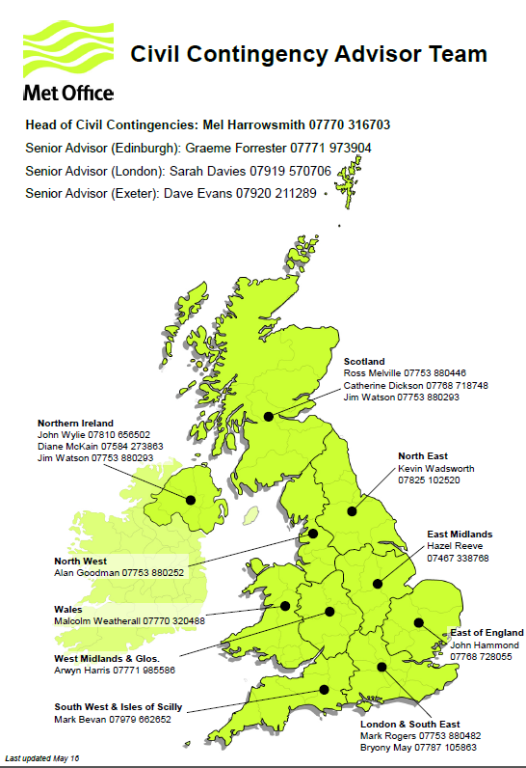
Advisor for South-West England
Population around 5 million with about 50% increase in summer months
About 300 miles from west to east

Slide 4
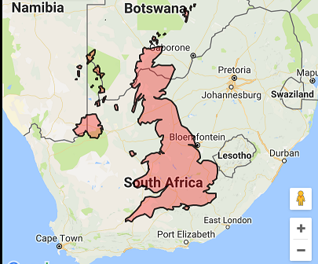
A sense of scale...

Slide 5
Why warnings?
Group Exercise
Within your groups - discuss:
Why do we need warnings?
Who needs warnings?
Be ready to present your teams thoughts back to the group as part of a discussion in 15 minutes.
Notes:
Divide into 3 to 4 groups (table rows?)
Why do we need warnings? How are they different to a normal forecast? Why is this important?
Who needs them? Public, responders, media. Are their needs the same? Key point through the next few days is who the warning is for and to make sure we fulfil their requirements. We will look at why this is important in the next session.

Slide 6
Why warnings?
Group Exercise
FEEDBACK
Notes:
Divide into 3 to 4 groups (table rows?)
Why do we need warnings? How are they different to a normal forecast? Why is this important?
Who needs them? Public, responders, media. Are their needs the same? Key point through the next few days is who the warning is for and to make sure we fulfil their requirements. We will look at why this is important in the next session.

Slide 7
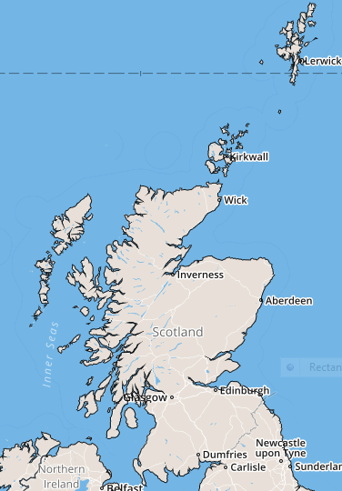
Scotland

Slide 8
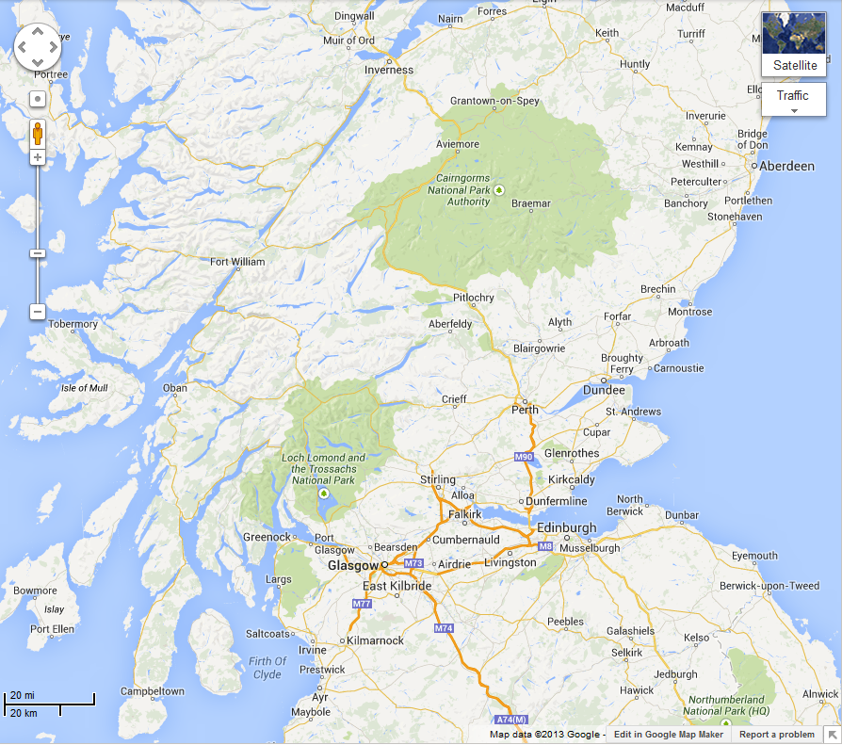
Scotland
Most of Scotland’s 5 million people live in this area – the “Central Belt”

Slide 9
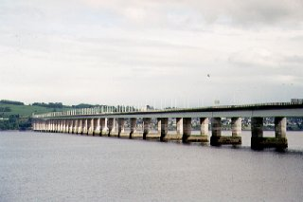
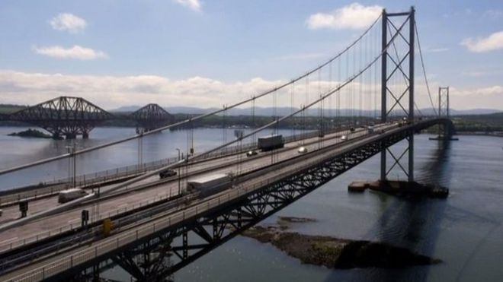
Scotland

Slide 10
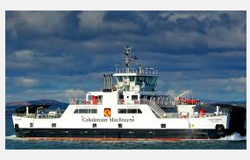
Scotland

Slide 11
Case Study 1

Slide 12
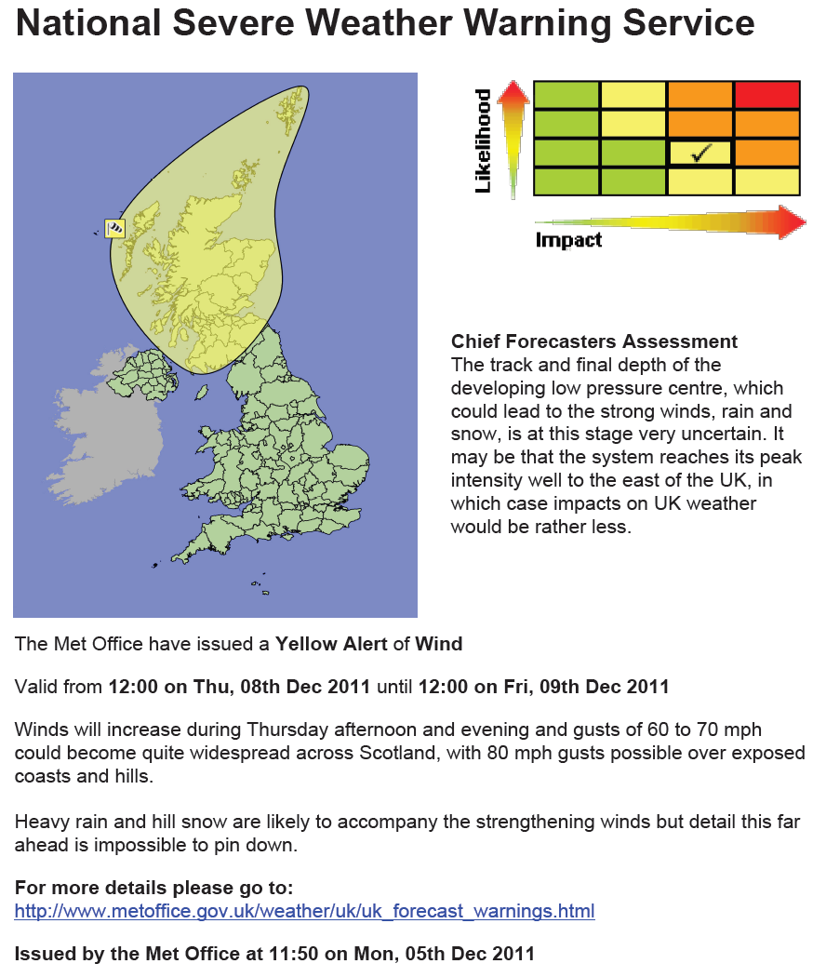
5th December 2011
First indications of a deep depression
Potential for winds to 60-70 mph, possibly 80 mph
Significant impacts possible
Uncertainties in where the strongest winds will be (Possibly offshore)

Slide 13
6th December
Warning updated in the morning but later in the day…
Situation looks even more serious
Advisor contacted key contacts in Scotland during evening of Tues 6th highlighting potential for winds in excess of 85mph through the Central Belt on Thu 8th

Slide 14
7th December
Scottish Government convene emergency committee (SGoRR) at 10am
Advisor briefs on potential for 80-90 mph winds through central belt
Information from police and transport agency indicated main bridges were likely to close completely at the forecast wind speeds, creating the risk of gridlock in important parts of the motorway network.

Slide 15
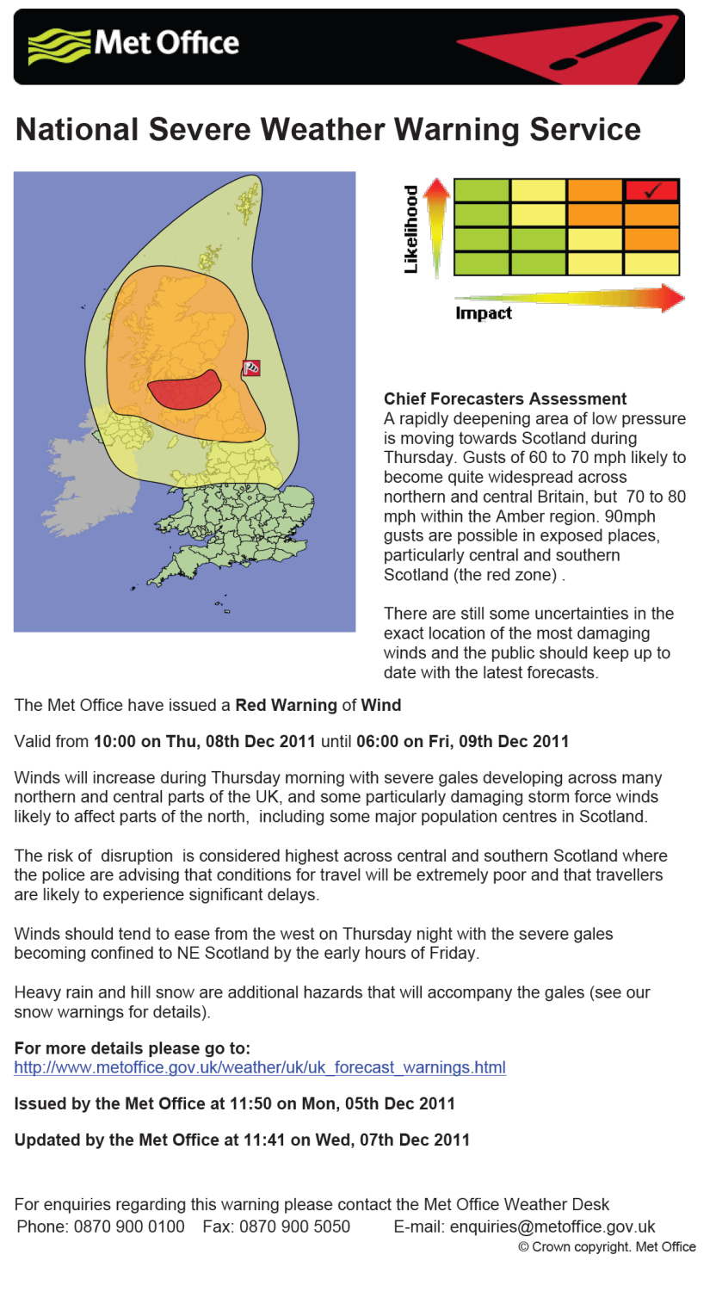
7th December 2011
Met Office now feel the likelihood of the event is HIGH
Information from partners indicate impact will be HIGH
RED warning issued at 24 hours in advance of event
Messages sent by the advisors to responders across Scotland

Slide 16
Actions Taken
Messages from Advisors to emergency responders throughout Scotland highlighted potential for widespread transport and power supply disruption and structural damage with gusts of the expected magnitude.
Telephone calls made to Police contacts in advance of RED warning being issued.
Met Office Advisor deployed to Transport Scotland Multi-Agency Response Team (MART) at Control Centre (8th & 9th)
Advisor briefed Scottish Government officials and ministers before and during the event.
Scottish ministers “advised” closure of schools on the 8th.
Police advised people not to travel

Slide 17
What happened?
Wind speeds of 80-100 mph recorded through the Central Belt
Widespread travel disruption, power cuts and school closures across Scotland.
All main bridges were closed.
Speed restrictions on railways due to the risk of trees and other debris on rail lines.
Ferry services were delayed and some flights were cancelled.
Estimated 150,000 homes without power.
Many trees were brought down, west-facing coasts were battered by large waves and there was some building damage.
Localised flooding in northern England too.

Slide 18
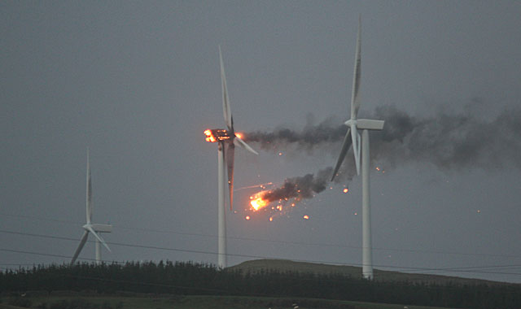
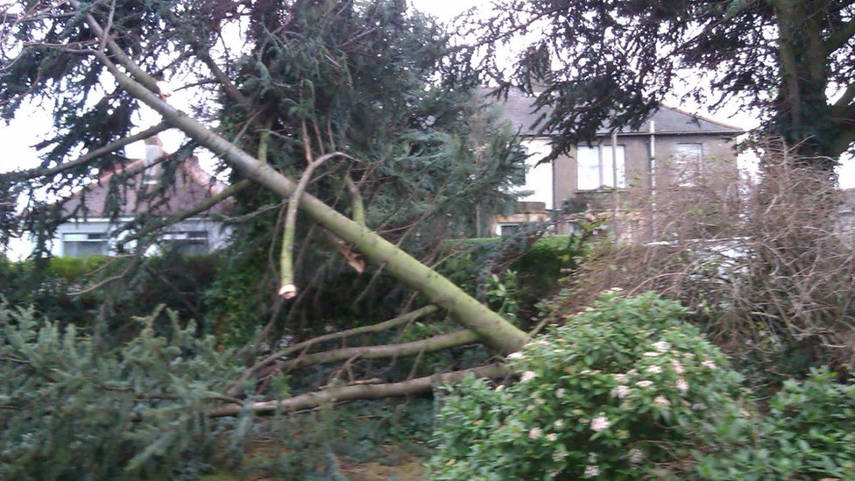
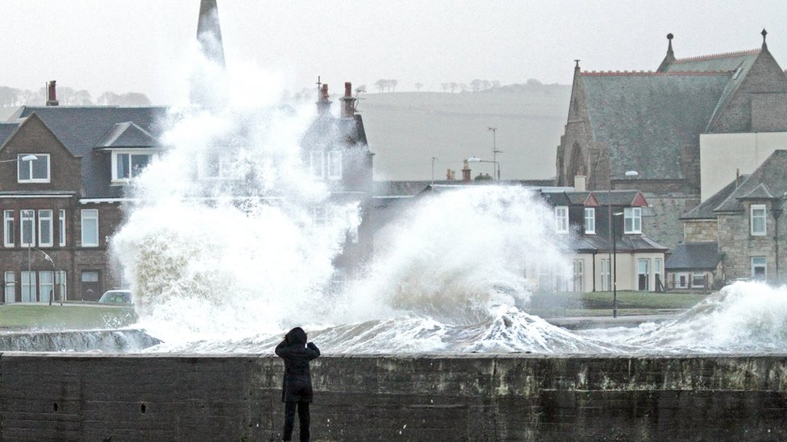
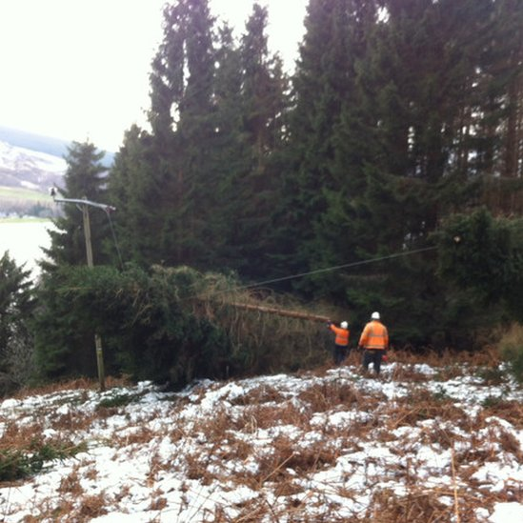
8th December 2011
Ayrshire
Edinburgh
Troon
Argyll
Notes:
Pics of some of the scenes during the storm of 8th December

Slide 19
Case Study 2

Slide 20
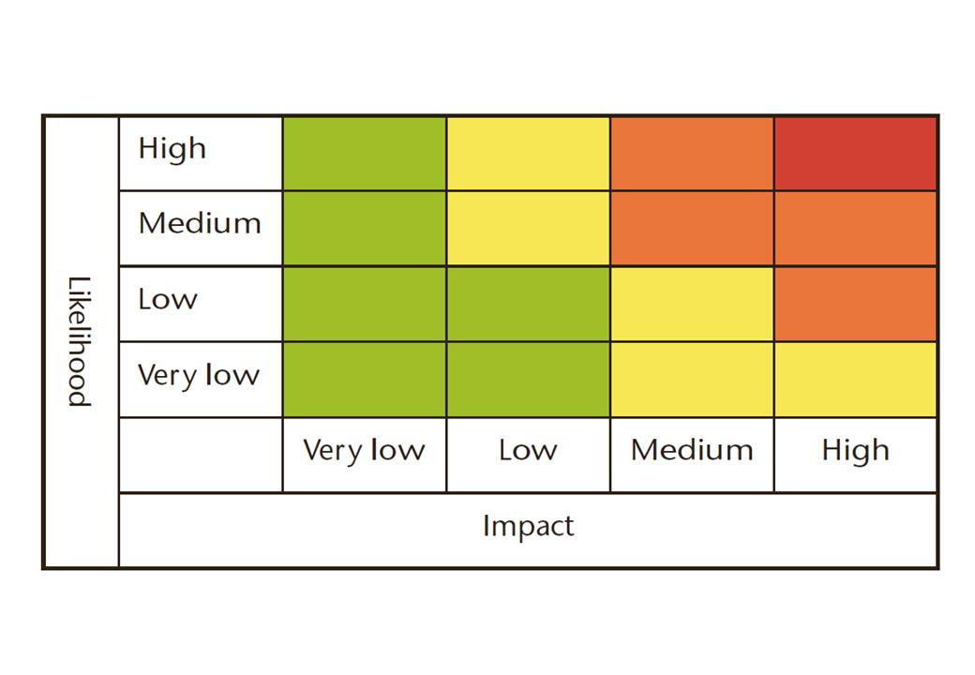
Wind event November 12th/13th 2015
Tuesday 10th November
Forecast of gales for NW of Scotland – up to 80 mph
Communities here are very resilient to strong winds but work with local responders suggested that Very Low likelihood of Medium Impacts warning was appropriate meaning A Yellow Warning was issued
✓

Slide 21
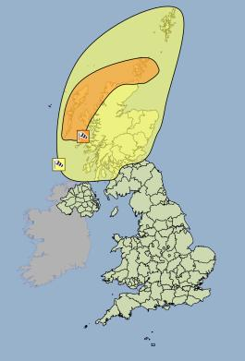
Wind event November 12th/13th 2015
On Wednesday 11th November:
Forecast more confident for the main area, and also a risk of strong winds further south.
Medium likelihood of medium impacts (Amber) - with low likelihood of medium impacts (Yellow) area expanded.
✓
✓

Slide 22
Wed 11th
Notes:
The Met Office have issued an Amber Warning of Wind
Valid from 21:00 on Thu, 12th Nov 2015 until 12:00 on Fri, 13th Nov 2015
Southwesterly severe gales will develop later on Thursday, increasing storm force for a
time as they veer westerly overnight into early Friday. Gusts of 70 to 80 mph are likely, and
perhaps 90 mph across exposed locations. Winds will begin to ease and veer more
westerly across the Western Isles and the mainland on Friday morning and across the
Northern Isles on Friday afternoon.
Lighting associated with frequent showers will be an additional hazard, whilst large waves
may lead to over-topping along some coasts and causeways.
The public should be prepared for disruption to transport and perhaps power supplies.
The Met Office have issued a Yellow Warning of Wind
Valid from 18:00 on Thu, 12th Nov 2015 until 14:00 on Fri, 13th Nov 2015
Southwesterly severe gales are likely to develop across the north and west of Scotland
later on Thursday and then extend across eastern areas and the Northern Isles into Friday
morning. Gusts of 60-70 mph are likely with the possibility of gusts to 80-90 mph in
exposed locations across the north and west of the area. Winds will begin to ease and veer
more westerly across the Western Isles and the mainland on Friday morning and across
the Northern Isles on Friday afternoon.
Lightning associated with frequent showers will be an additional hazard over northern and
western areas
The public should be aware of the risk of disruption to transport. In addition, large waves
may give rise to local over-topping along some coasts.
This is an update to the alert originally issued on Tuesday to extend the yellow area further
south and east, and also to escalate the likelihood of impacts in the risk matrix.

Slide 23
Advisors actions
Daily email to all emergency responders in the area giving more context
Contact key transport and government colleagues
Take part in regional teleconferences as responders prepare for the event
Media
Met Office Press Office ensures broadcast partners are aware and have the correct story
Much done on social media, tweets etc
The storm was named “Abigail”

Slide 24
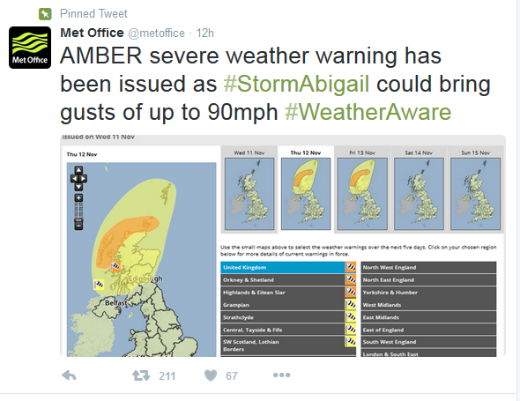
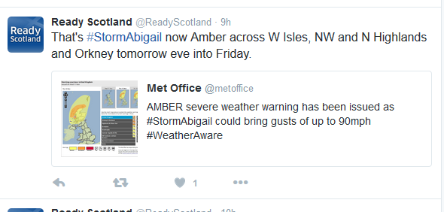
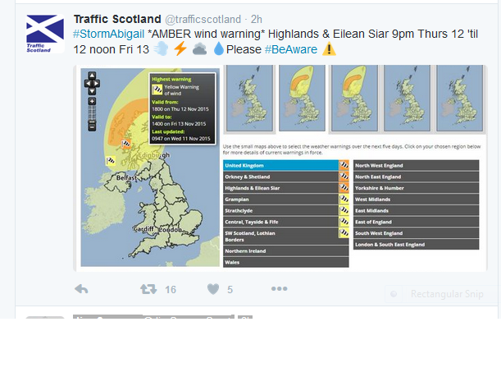
We tweet, partners re-tweet

Slide 25
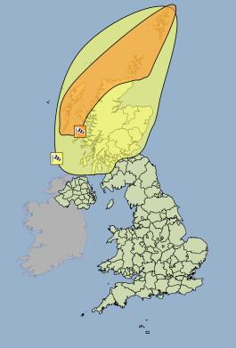
Thurs 12th – Final issue
Amber area extended to include Shetland
Yellow area remained much the same - Central Belt still included.

Slide 26
Impacts
Power cuts
Serious disruption to ferry services
Schools closed in Western Isles (pre-emptive action)
After the event
Were the impacts in line with those forecast?
Feedback from Responders
Information from Social Media and News Media
Lessons used for future events

Slide 27
Questions?

